Slide 1
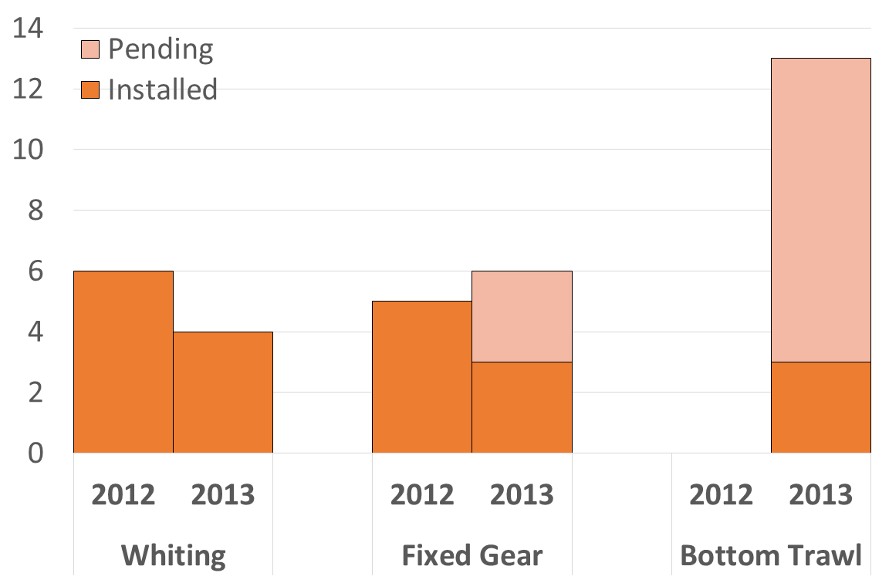
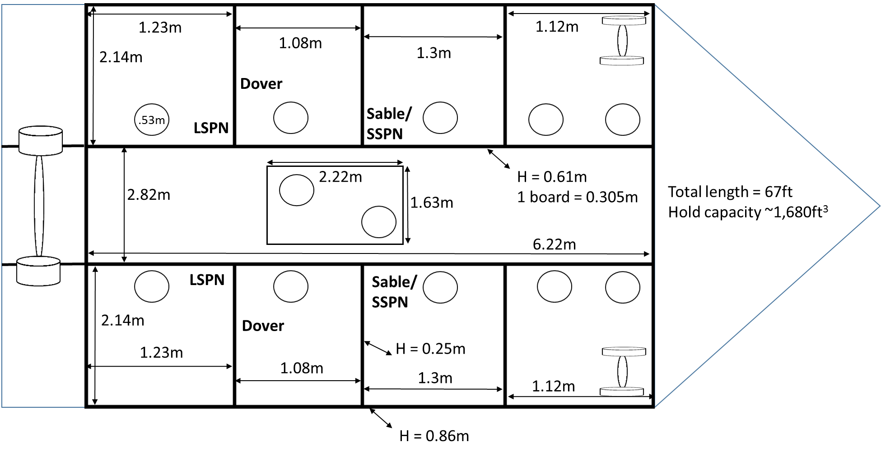
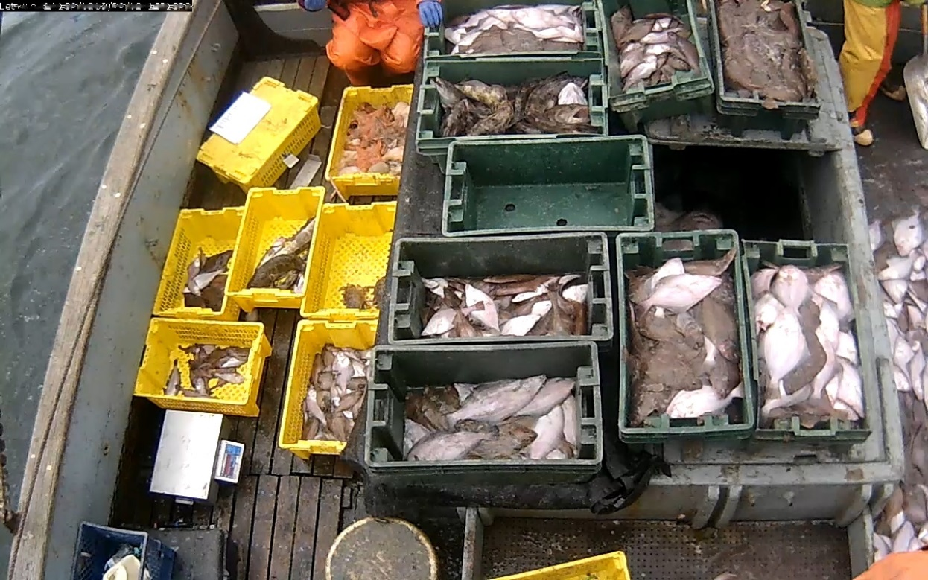
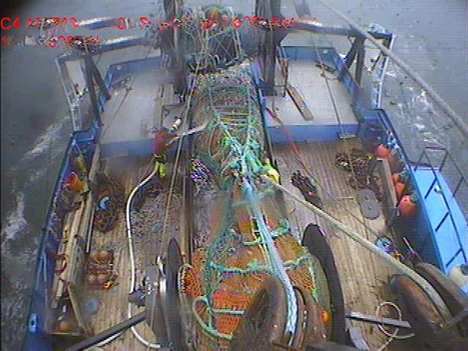
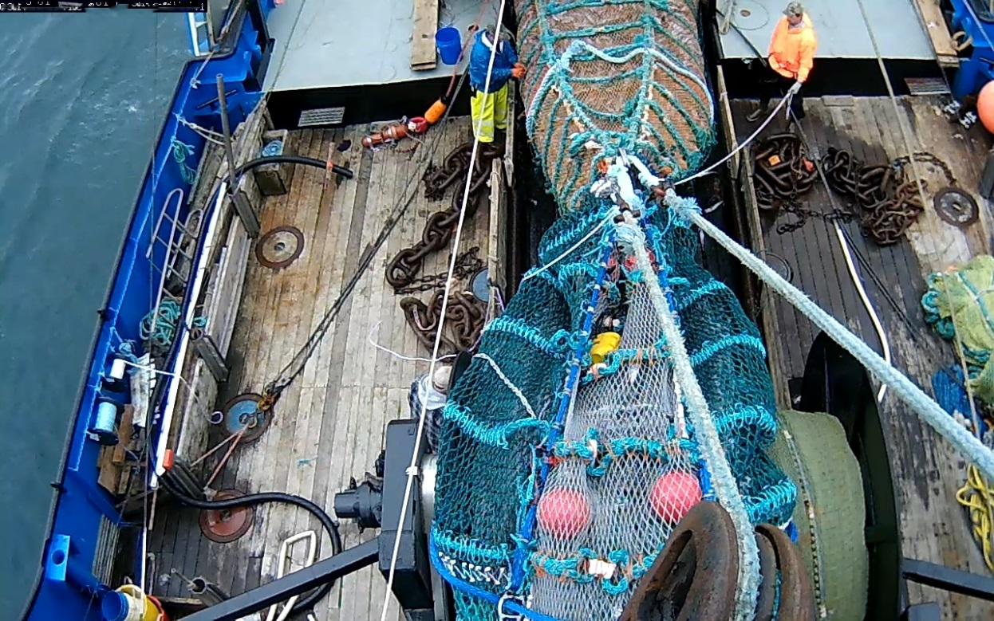
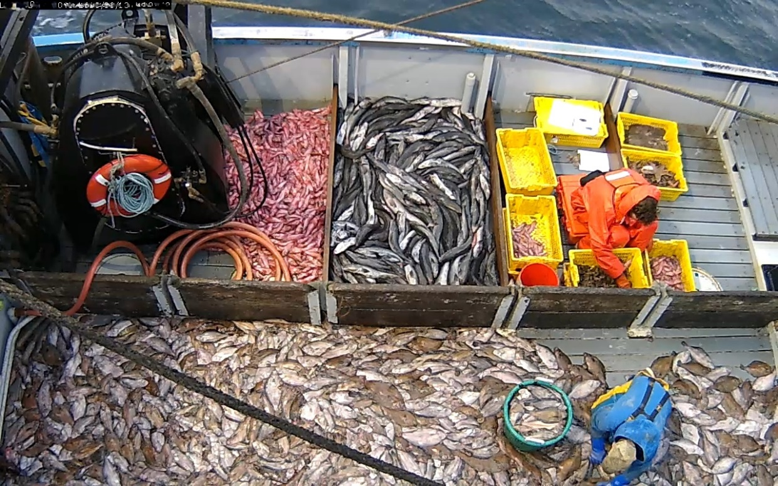
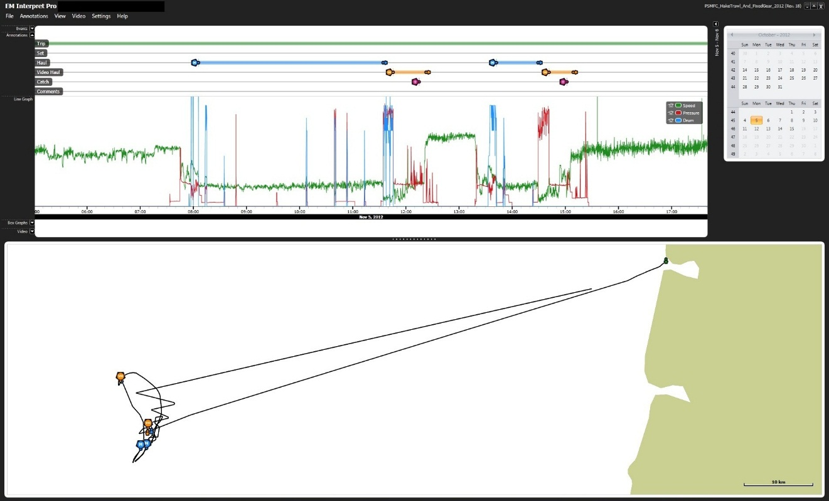
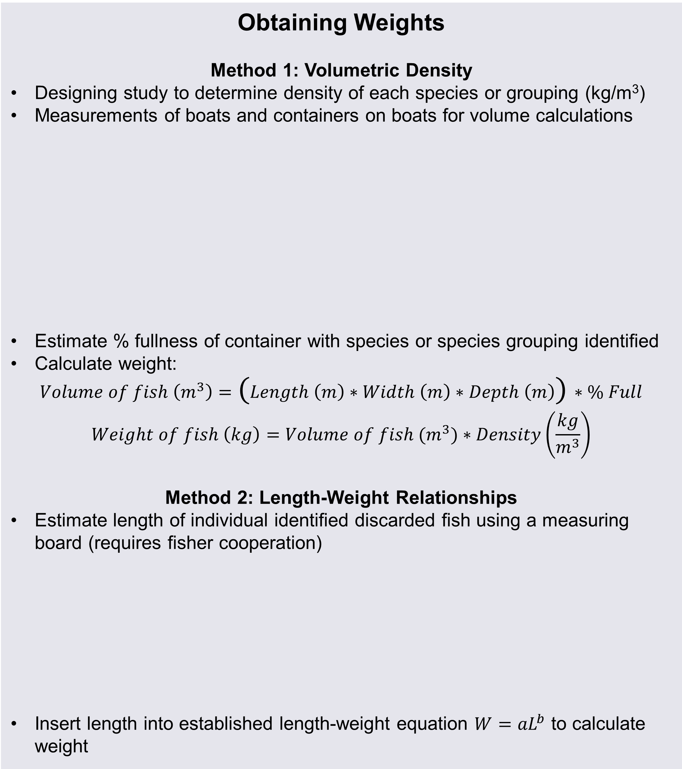
West Coast Groundfish Trawl IFQ Electronic Monitoring Program
PSMFC Involvement
Courtney Donovan, Ryan Easton and Alia W. Al-Humaidhi
Pacific States Marine Fisheries Commission
Phone: 503-595-3100
PSMFC began testing EM systems on three sectors of the west coast groundfish Individual Fishing Quota (IFQ) fishery in the summer of 2012. The project expanded to include bottom trawl vessels in 2013.
Objective
To test the viability of Electronic Monitoring (EM) as a source of data to achieve effective individual accountability of catch and bycatch in the Pacific Trawl Rationalization Program.
Obtaining Weights
Method 1: Volumetric Density
Designing study to determine density of each species or grouping (kg/m³)
Measurements of boats and containers on boats for volume calculations
Estimate % fullness of container with species or species grouping identified
Calculate weight:
$$Volume of fish \left(m^{3}\right)=\text{(}Length \left(m\right)∗Width \left(m\right)∗Depth \left(m\right)\text{)}∗\% Full$$
$$Weight of fish \left(kg\right)=Volume of fish (m^{3})∗Density\left(\frac{kg}{m^{3}}\right)$$
Method 2: Length-Weight Relationships
Estimate length of individual identified discarded fish using a measuring board (requires fisher cooperation)
Insert length into established length-weight equation $W={aL}^{b}$ to calculate weight
Relevance
The Pacific Fisheries Management Council is considering EM for use in the Pacific Trawl Rationalization Program to assess methods of catch and bycatch monitoring of the fishery that are viable substitutes for the current 100% human at-sea monitoring.
2012 Results
Fixed Gear Sector:
Vessels and Willing Participants
Camera Systems
Field Services
Database to Support Infrastructure and Analysis of Data
Software to Expedite Review Time
Review Sensor and Video Data
Install Systems
Fix camera systems
Retrieve hard drives
Moving parts of an EM Program
At-sea Hake Sector:
Shoreside Hake Sector:
Issue
Working Solution
Obtaining weights of catch and bycatch
Volumetric density, length/weight relationships with measurement strips, and full retention studies
Accurate Speciation
Digital cameras improve the resolution of images captured
Discard Chute Study
Camera Systems
Accurate speciation
Digital cameras, full retention/discard chute study
Analog Camera
Digital Camera
Camera systems typically consist of:
Video cameras
Sensors for:
  Location and speed (GPS)
  Fishing activity indication (drum rotation or hydraulic pressure)
Control box that controls the system and stores the data.
Changes in fisher behavior needed for clear camera views
Feedback forms and direct contact
Data security
Encryption
Data review time
Logbooks as data source and audit a percentage of the video data
Fisher throws fish that would have been discarded through a chute with mounted camera into a separate container
“Discard” fish are sorted and quantified at the dock
Species ID and length information is captured by the video reviewer
Speciation and weight estimates from video are compared to dockside values
Difficult to Speciate Small Red Rockfish and Mixed Flatfish
Defining catch and discard
NMFS working to develop clear definitions
Acknowledgements
We would like to thank the owners, skippers, and crew of the participating fishing vessels for volunteering and helping this project move forward. We would like to thank the West Coast Groundfish Observer Program for providing at-sea compliance monitor data.
Notes:
Genetic analyses (Israel et al. 2009):
97% of green sturgeon samples collected in the Sacramento river belong to the southern DPS
green sturgeon population found in the Columbia river is “composed almost exclusively” from the southern DPS

