Slide 1
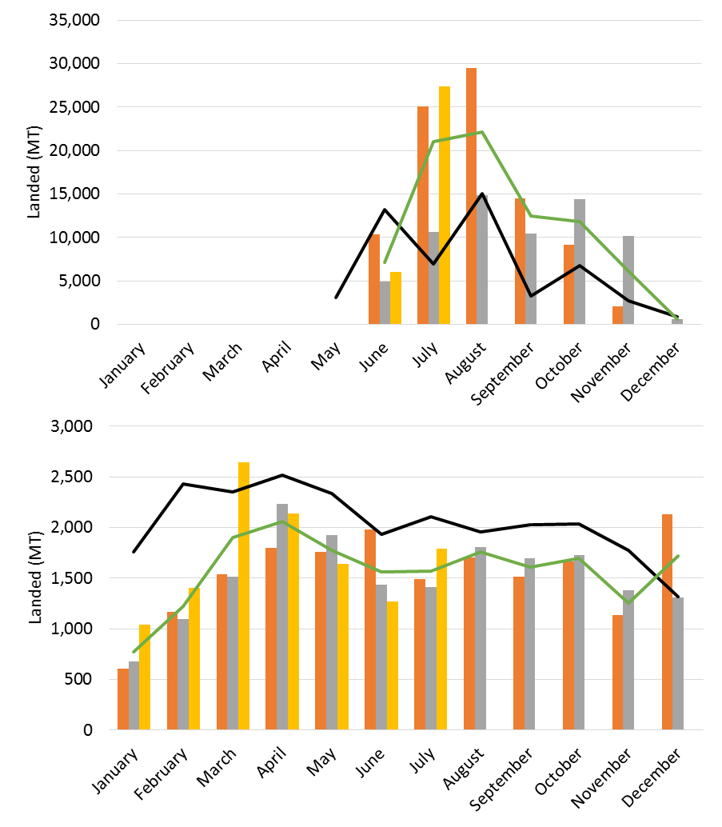
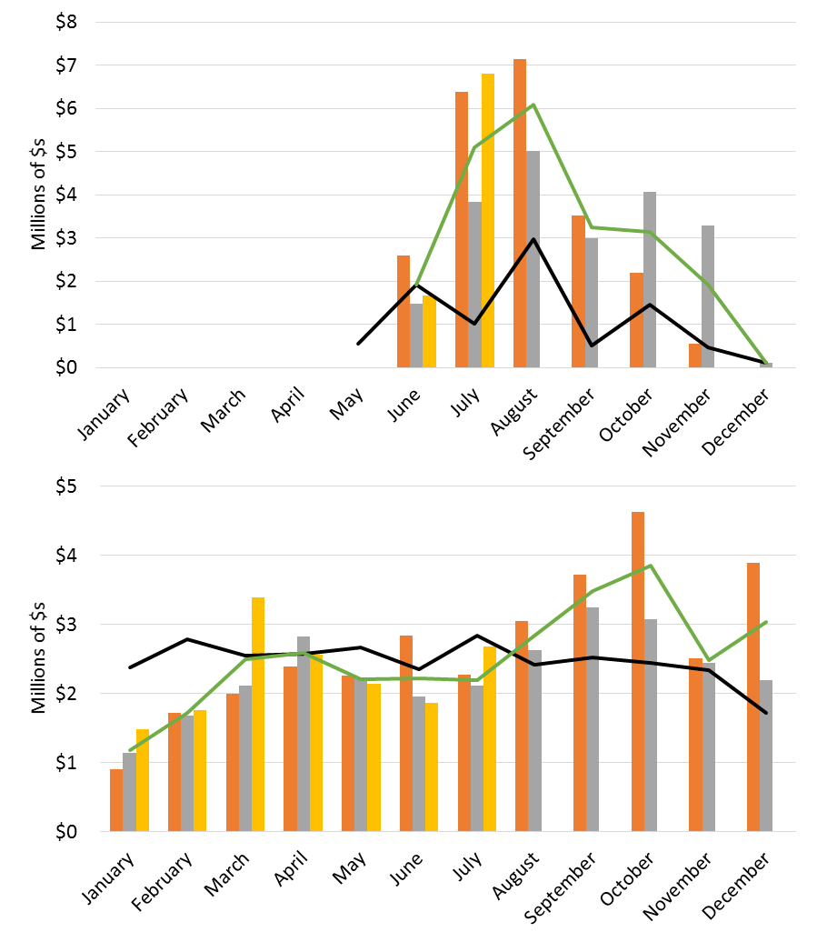
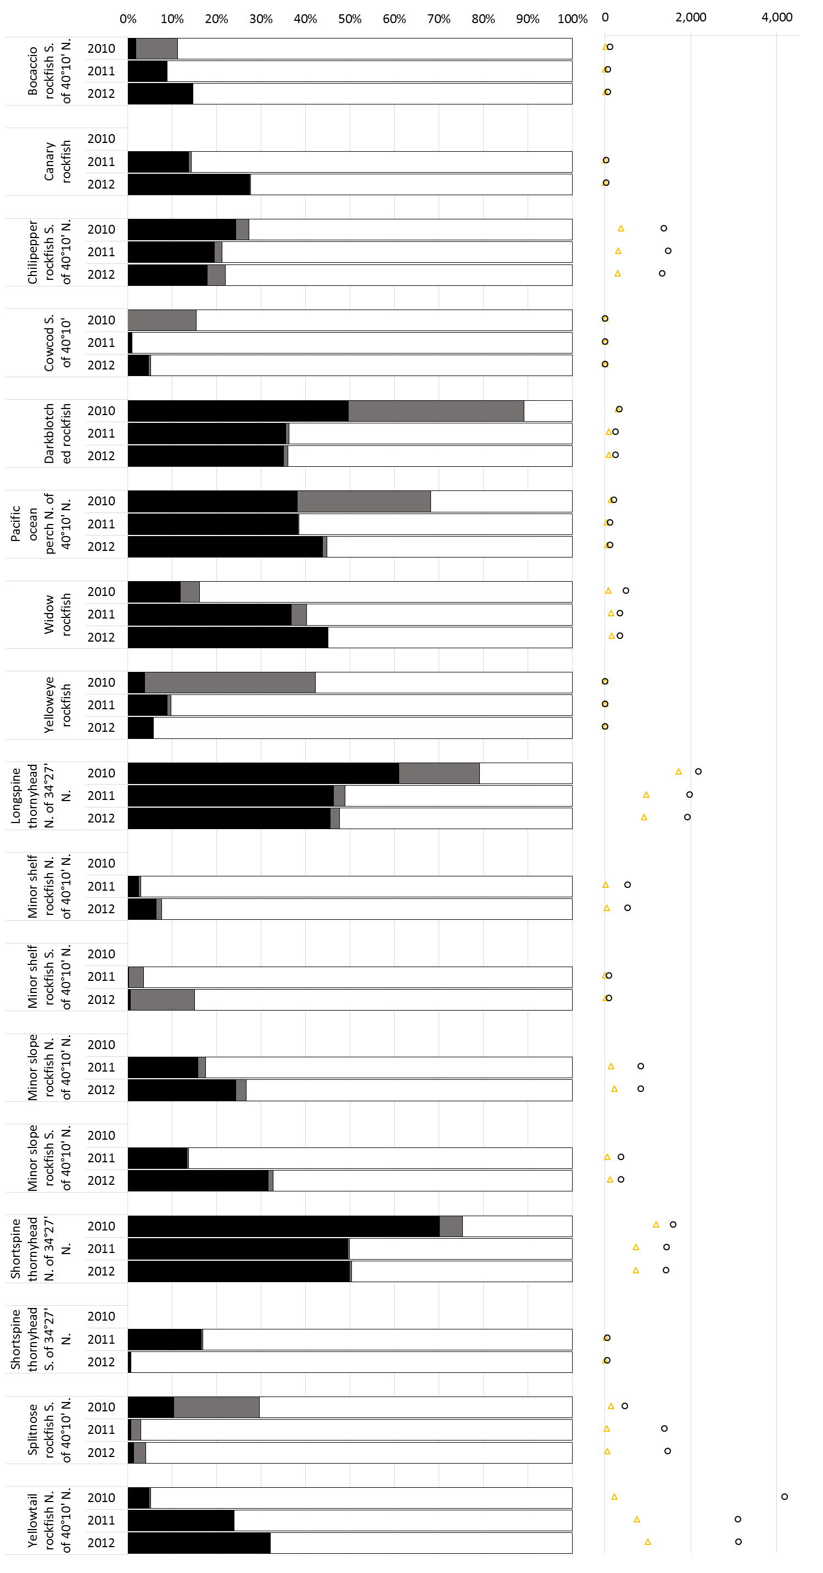
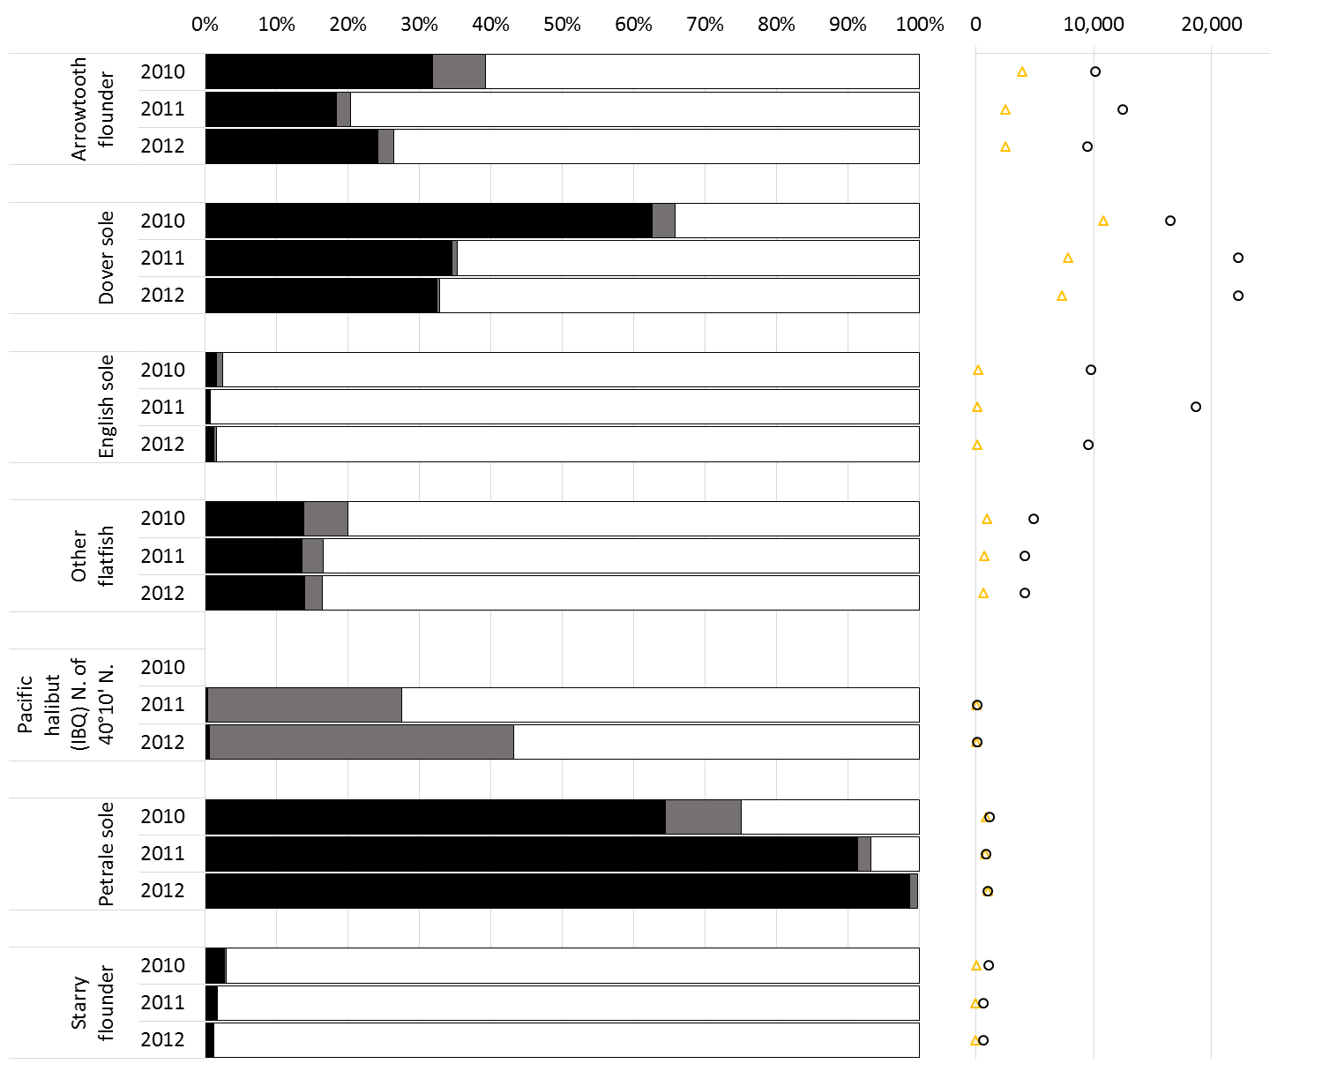
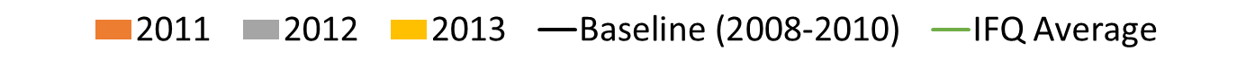
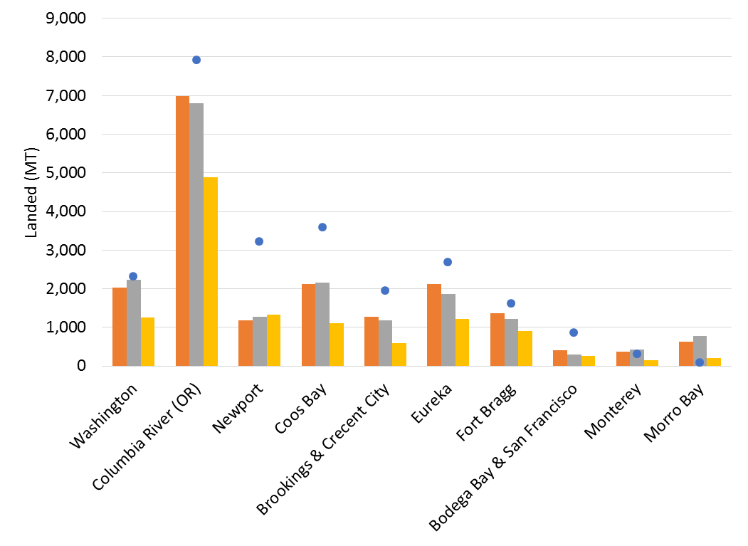
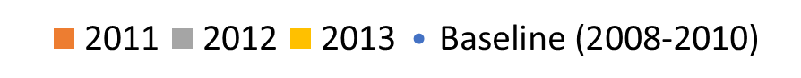
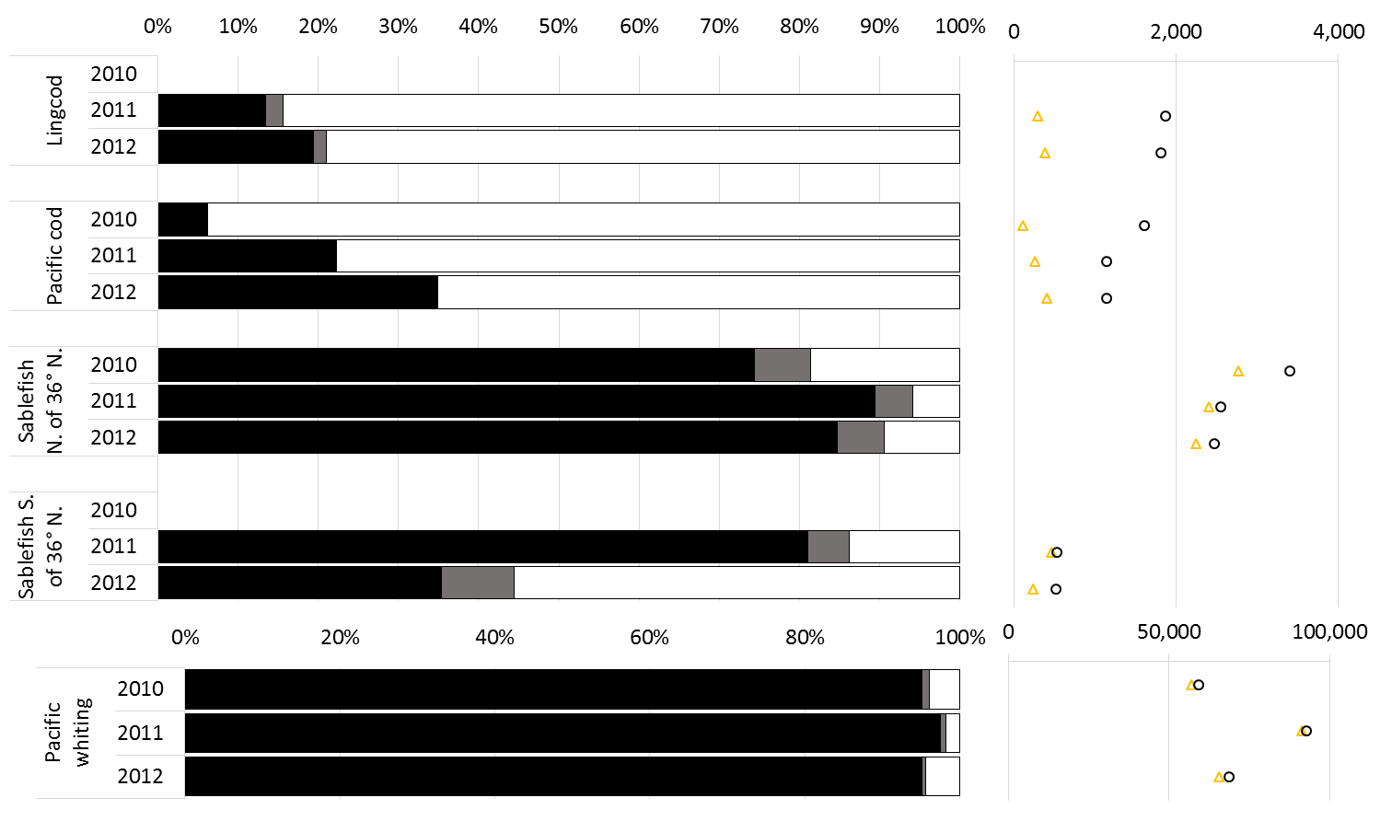
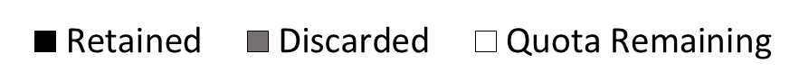
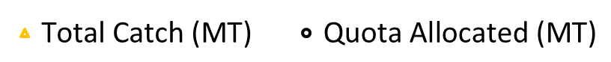
West Coast Groundfish Trawl IFQ Program
Alia W. Al-Humaidhi ▪ Pacific States Marine Fisheries Commission ▪ Phone: 503-595-3100
Overview
In January 2011, NOAA implemented the Pacific Trawl Rationalization Program, or the West Coast Groundfish Individual Fishing Quota (IFQ) Fishery.
Quota for each species or species grouping is divided by NOAA-NWR among quota share holders allowing fishermen to fish quota when market, weather, and fishing conditions are most favorable.
The fishery consists of roughly four sectors:
    At-sea hake, Shoreside hake, Shoreside Fixed gear, Shoreside Bottom trawl
All values presented on this poster represent the shoreside sectors of the IFQ fishery
Trends – Comparing Pre- and Post- IFQ
Landings by Month
Ex-vessel Revenue By Month
Shoreside Hake
How much of the allocation for each IFQ grouping was caught (2010 - 2012)?
Non-Hake
Rockfish
Flatfish
Percent of Allocation
Catch & Quota (MT)
Percent of Allocation
Catch & Quota (MT)
Baseline values do not include any LE fixed gear fishing from 2008-2010
2013 values represent fish tickets through July 31, 2013
Data sources: PacFIN, eTickets
Landings by Port Group
Shoreside hake sector not presented due to confidentiality
2013 numbers represent landings through July 31, 2013 only
Non-Hake
Roundfish
*
Percent of Allocation
Catch & Quota (MT)
Baseline values do not include any LE fixed gear fishing from 2008-2010
* 2013 values represent fish tickets through July 31, 2013
Data sources: PacFIN, eTickets
Summaries
2013 numbers represent landings through July 31, 2013 only
Shoreside Hake
Data sources: NWR Vessel Account System, eTickets, 2010 Groundfish Mortality Report
Bellman, M.A., A.W. Al-Humaidhi, J. Jannot, J. Majewski. 2011. Estimated discard and catch of groundfish species in the 2010 U.S. west coast fisheries. West Coast Groundfish Observer Program. National Marine Fisheries Service, NWFSC, 2725 Montlake Blvd E., Seattle, WA 98112
Non-Hake
Quota for most IFQ species or groupings were partially caught in 2011 and 2012 in the shoreside sectors.
2010 values for quota utilization are presented for the limited entry (LE) trawl and shoreside hake sectors combined and only for species groupings that either had a sector specific allocation or 90% of the catch estimated in 2010 was made by the LE Trawl and shoreside hake sectors.
2010 values do not include any LE fixed gear fishing
* 2013 values represent fish tickets through July 31, 2013
Data sources: PacFIN, eTickets

