Slide 1


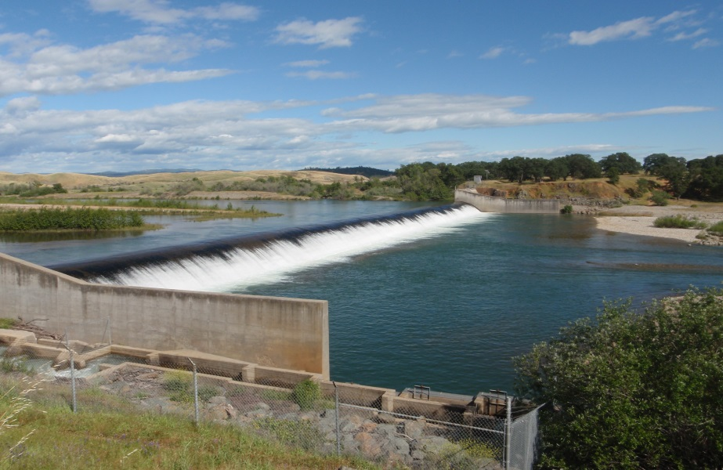

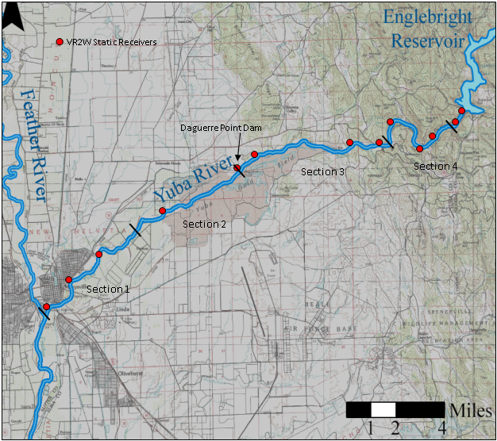
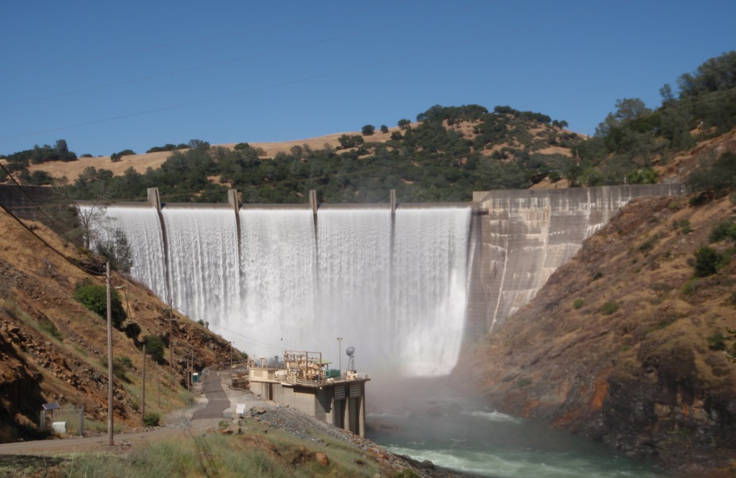
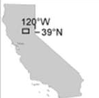
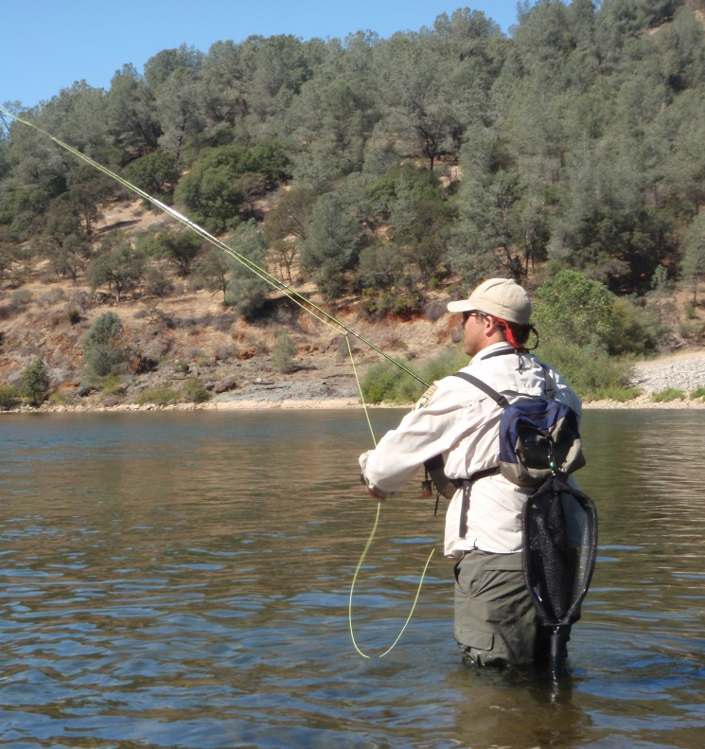
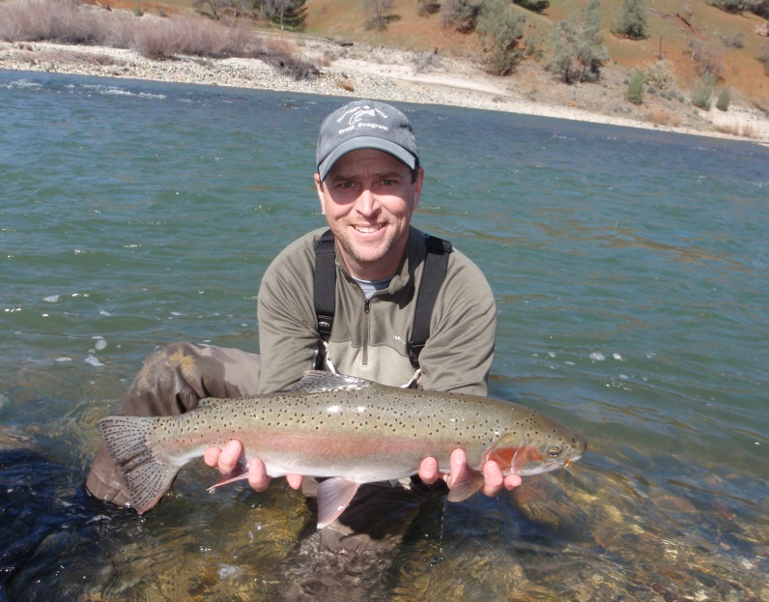
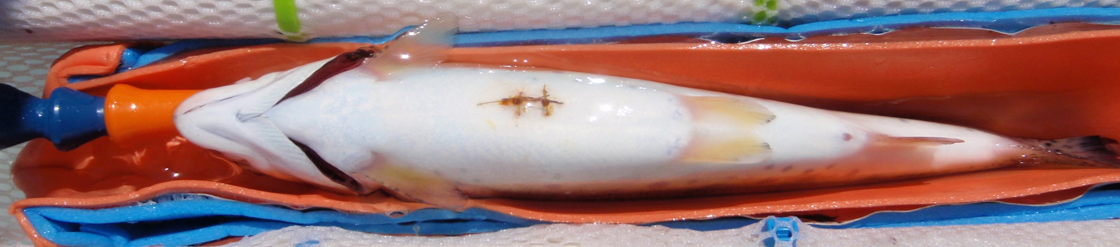
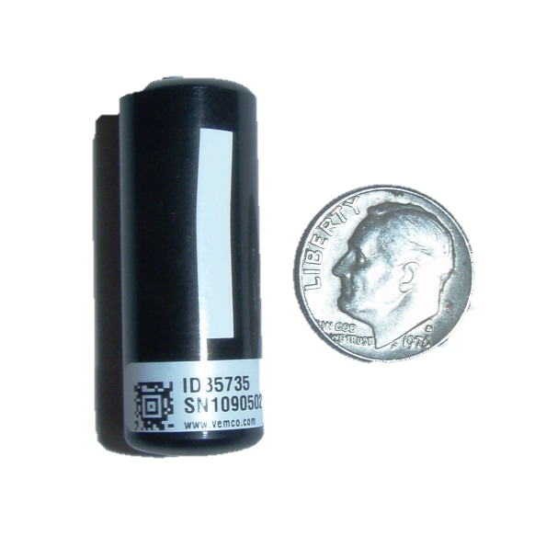
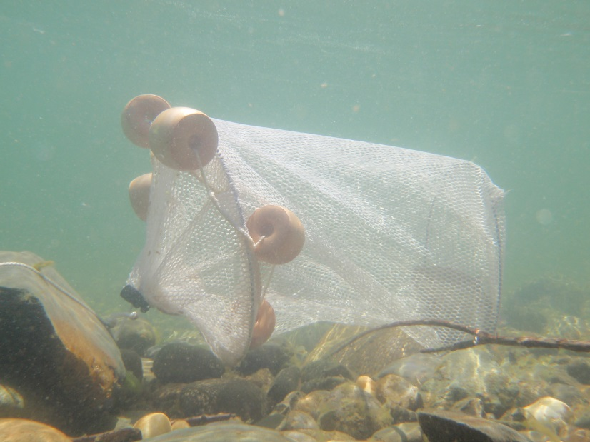
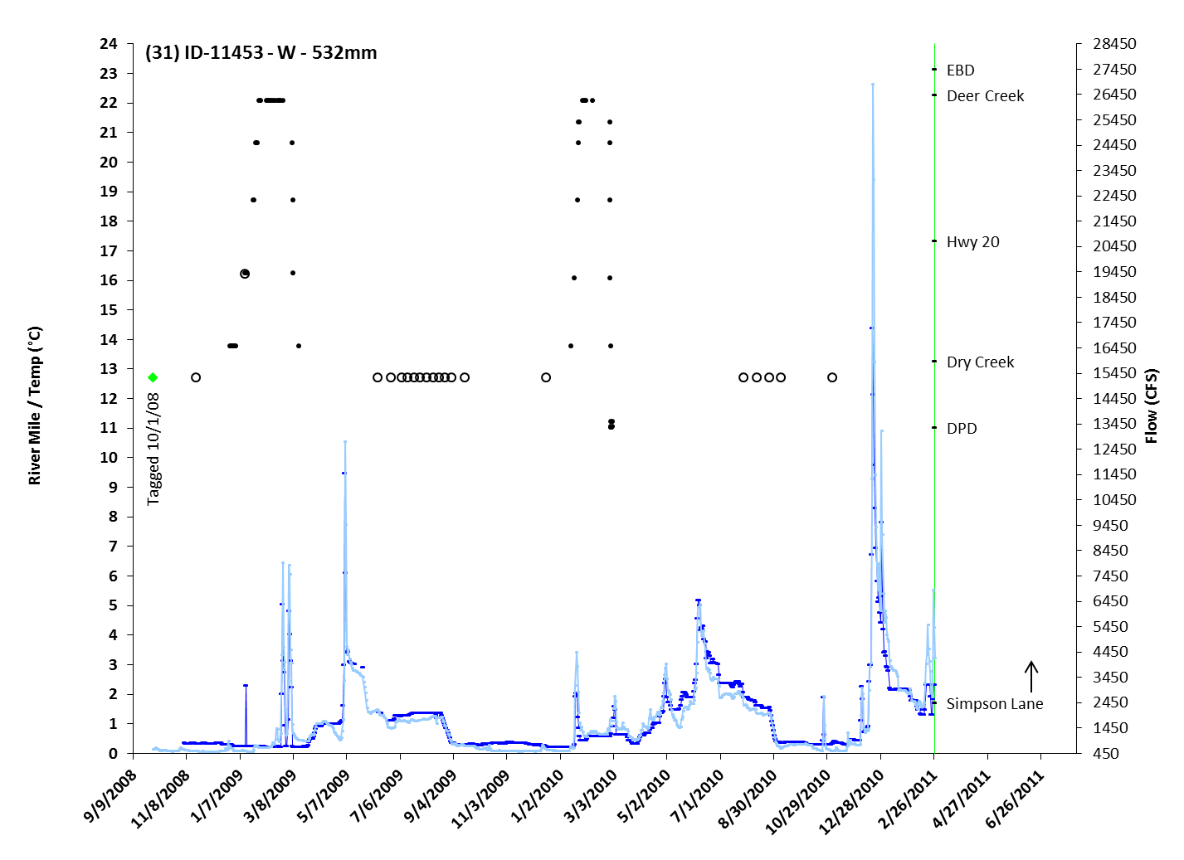
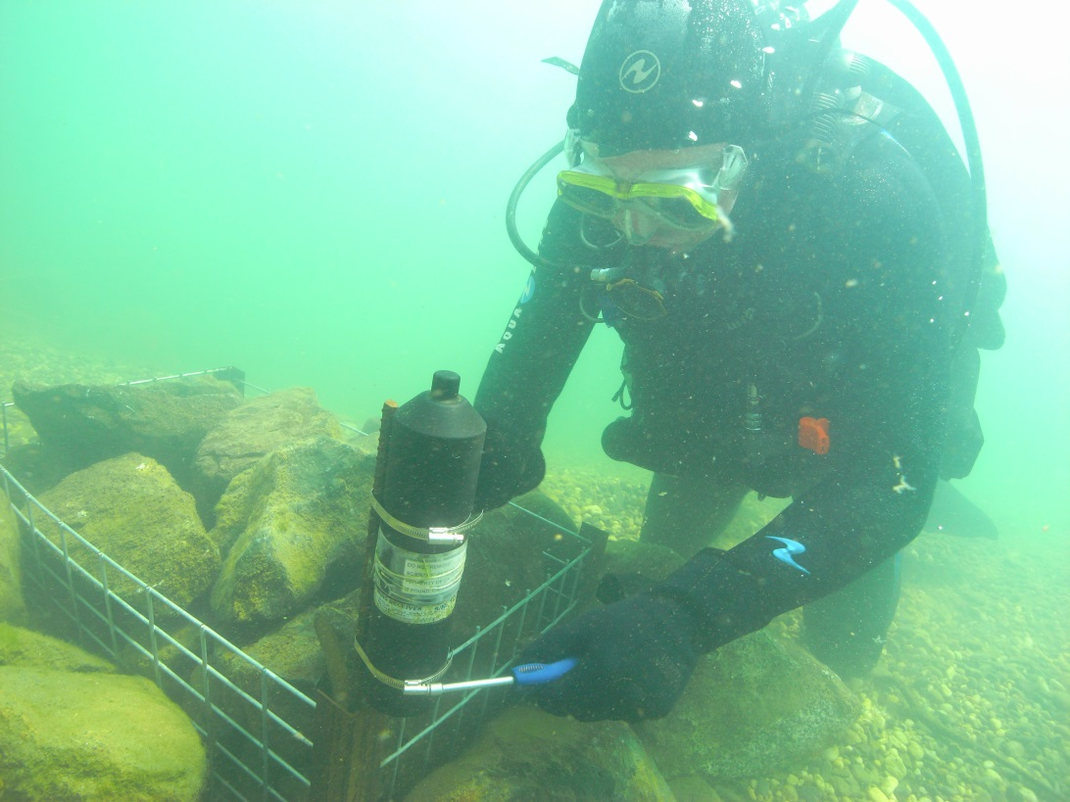
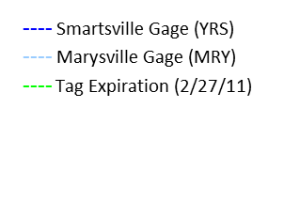
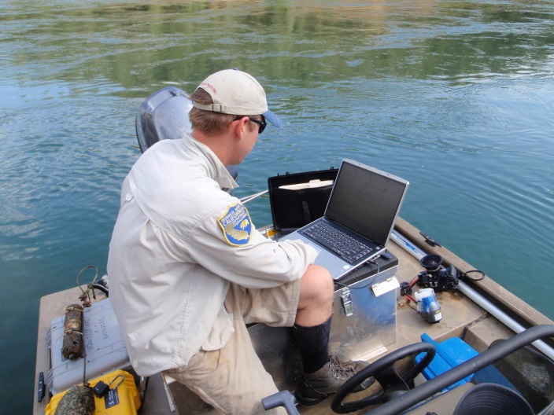
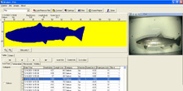


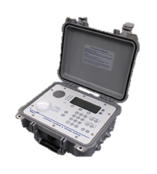
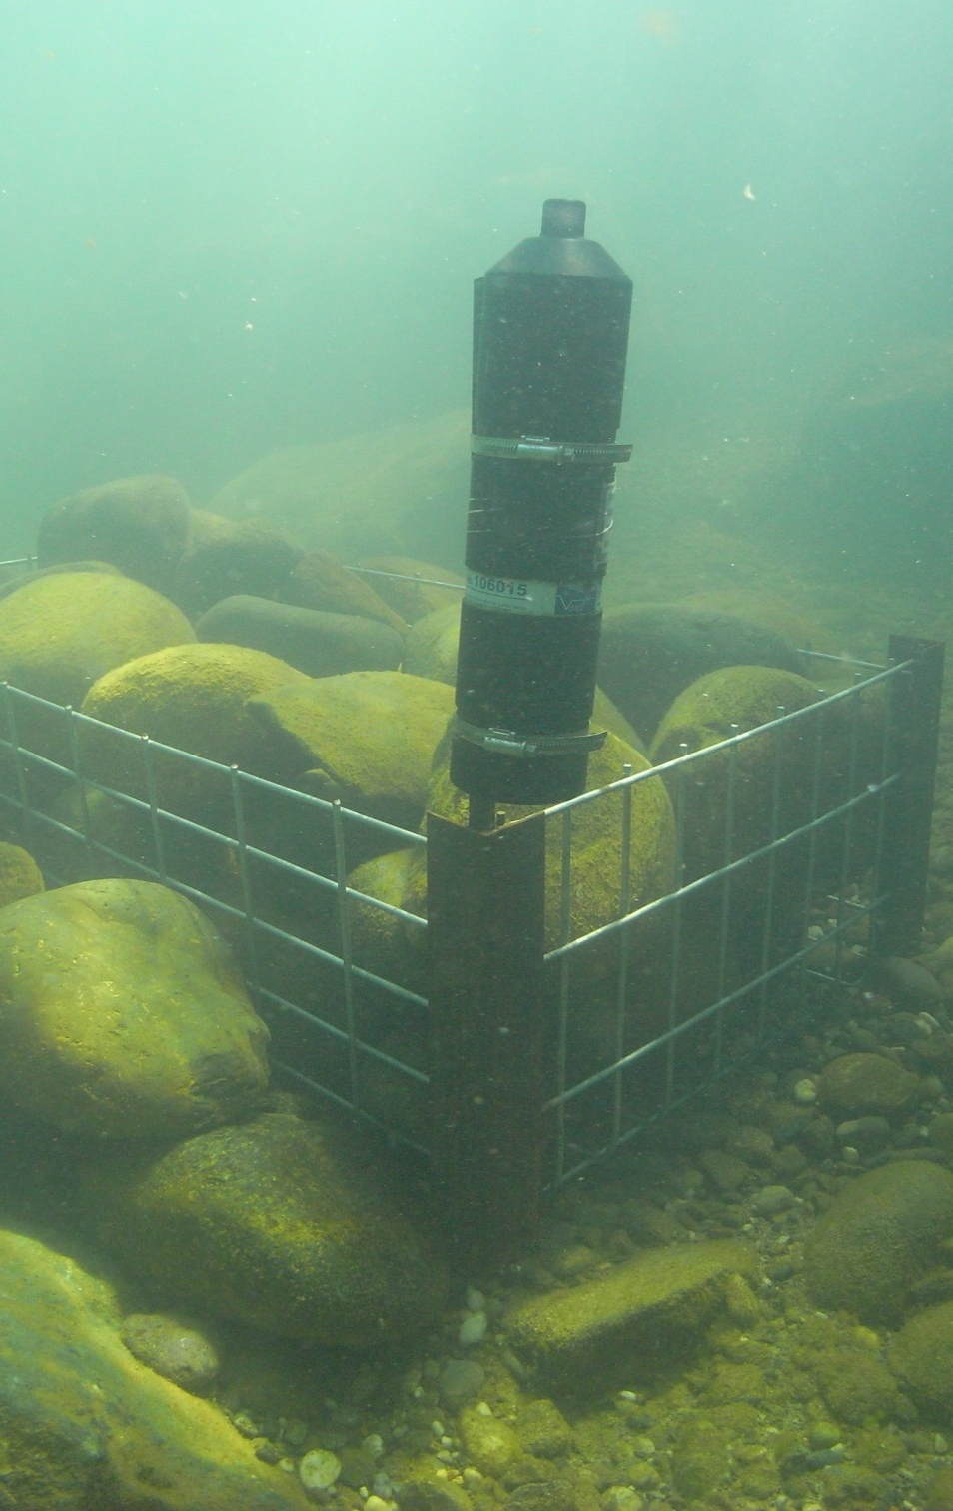
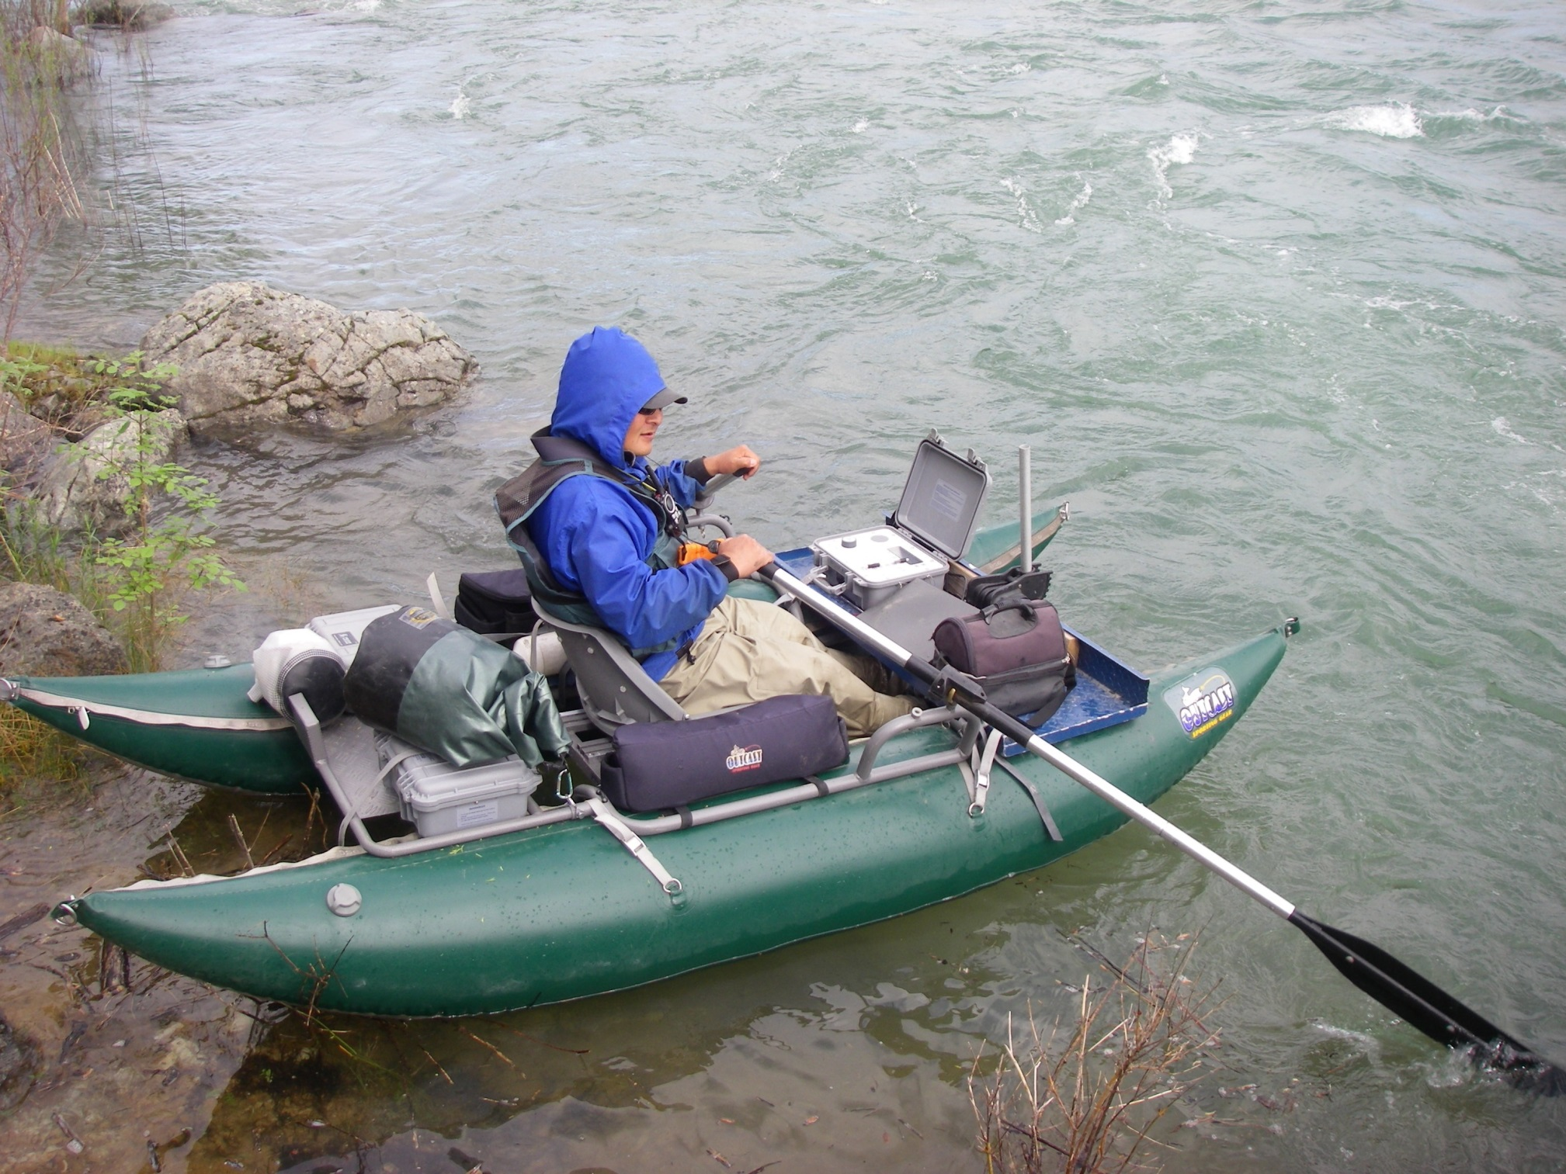
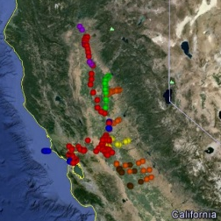


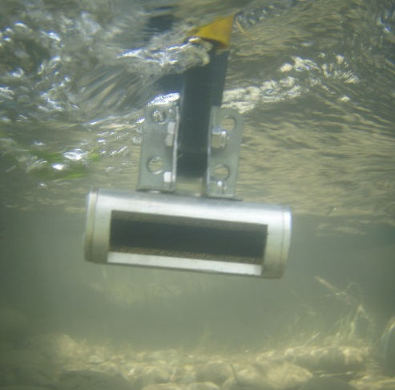
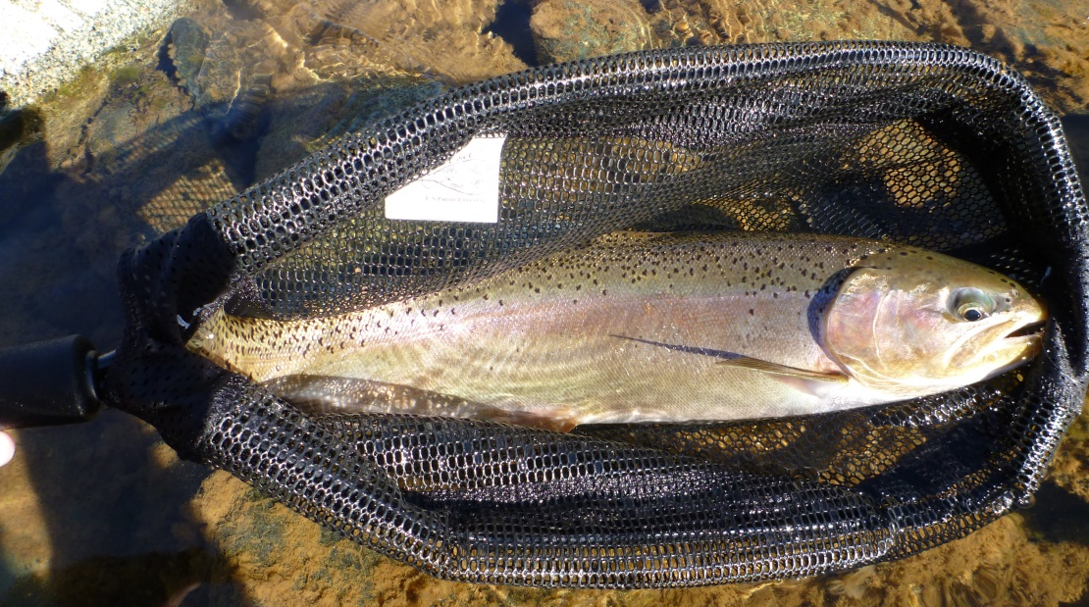
Monitoring Movement Patterns of Coastal Rainbow Trout
(Oncorhyncus mykiss) in the Lower Yuba River Using Acoustic Telemetry
L. Alber, J. Nelson, R. Bloom, and B. Hennes
Introduction
The lower Yuba River (Figure 1) is an ~ 24 mile reach from Englebright Dam to the Feather River confluence. It is unique to the Central Valley because it is one of the last rivers to have wild, native steelhead (Oncorhynchus mykiss) runs. While steelhead run size on the Yuba River was estimated to be ~ 2,000 adults in 1984 (McEwan & Jackson 1996), current status of the anadromous & resident population components are unknown.
VAKI Riverwatcher data (Figure 2), collected since 2003, provides a snapshot of O. mykiss movements at one location (DPD - RM 11) illustrating passing of ~ 100 to 700 O. mykiss 16 inches or greater per year. Anadromous & resident life history patterns cannot be distinguish by these data; therefore, acoustic telemetry is needed to assess movement patterns above & below DPD to determine how/if DPD influences passage & if O. mykiss are moving into other systems.
Out of river & anadromous movements have the potential to be captured by complimentary acoustic receiver arrays (Figure 3) in the Feather River, established by DWR, & in the Sacramento River, Delta,
and San Francisco Bay systems,
established by NOAA and UC
Davis.
Objectives
Progress
Daguerre Point Dam
Narrows Canyon
A total of 496 acoustic tags have been implanted since July 2008.
Preliminary stages of analysis are being conducted on fish whose acoustic tags have expired (Figure 9). Both static receiver range tests and mobile tracking efficiency tests are being, or have been conducted. Monitoring will continue through 2013. A final report will be published after the conclusion of the study.
1) The primary objective is to test the
difference, or lack there of, in migration of
O. mykiss between the following variables:
Seasons
Size/age class
Chinook salmon presence
Varying flow regimes
Origin
2) Data collected from this study will
contribute t0 improved management of
the species by evaluating current and
future;
Englebright Dam
Flow releases for improved fish habitat
Passage issues/improvement projects
Feather River Hatchery influence
Sport Fishing Regulation bag limits
3) In addition this data will provide
valuable information regarding;
Movement patterns
Emigration
River system utilization
O. mykiss distribution
Methods
Figure 9 - Graph of the movement pattern of one wild O. mykiss
KEY
Date Tagged
VR100 detection
VR2W detection
Figure 1 – Lower Yuba River with VR2W static receiver Locations
Fig. 4 – Surgery incision \ V13 acoustic transmitter \ recovery net
Tagging
Fish are captured via angling & implanted with a VEMCO acoustic transmitter (V13, V9, or V7) – (Figure 4).
Specific age classes are targeted in varying habitats, seasons, and sections.
Post surgery fish are recovered & released upon strong equilibrium & swimming ability.
VR2W Downloads
Additional Information
www.vemco.com
www.vaki.com
Hydra3.sound-data.com
Figure 2 – Infra Red scan \ video from VAKI Riverwatcher
Monitoring/Tracking
VR2W static receivers (Figure 5) monitor 24 hours/day and are retrieved, downloaded, and returned ~every 3 months.
Mobile tracking surveys (Figure 6) from the Narrows Canyon to the Feather River confluence allow movement to be tracked between static receiver locations.
VR2W Downloads
  Year round / bi-weekly
  Dual Pontoon Boat Tracks –
Figure 5 - VR2W static receiver
Figure 6 - Mobile Tracking Survey
Figure 7 – VR 100
VR100 mobile receiver
VH110 directional
hydrophone
Garmin GPS unit
Acknowledgments
PSMFC Yuba River Field Crew
Lower Yuba River Accord RMT
UC Davis Extension
Cordura Irrigation District
Yuba Recreation Inc.
Range Testing
Database created to facilitate data sharing used by the California Fish Tracking Consortium
Efficiency of this technique is being evaluated with a series of studies to compare detection rates of acoustic tags across different habitats, flows, and depths.
Figure 8 - VH110
Figure 3 – Central Valley Acoustic receiver arrays

